Slide 1

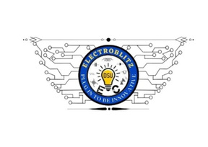
TEAM INTRODUCTION
Event Name
TECHNOCOGNITION’25 – International Level Protothon (36 Hours)
Team Members and Roles – Clean Sphere Innovations
Jalli Haneesha – Team Lead
B Deekshaa – Documentation & Presentation Coordinator
Charan Sreevasu J – Technical Research & Development
Project Context
In an effort to address the global challenge of providing clean drinking water in a portable and sustainable manner, the team presents an innovative solution – the Portable UVC Water Purification Bottle. This smart, IoT-enabled prototype is designed to ensure safe, on-the-go water purification. It offers a promising solution for travelers, remote communities (rural), and emergency scenarios where access to clean drinking water is limited.
TechnoCognition'25

Slide 2
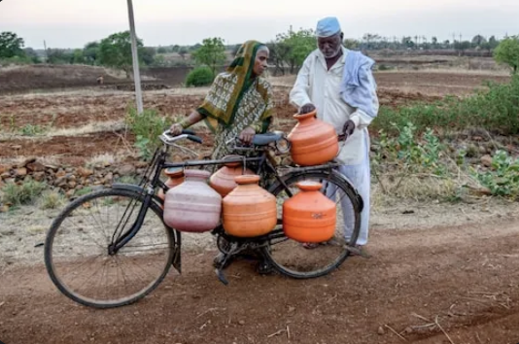

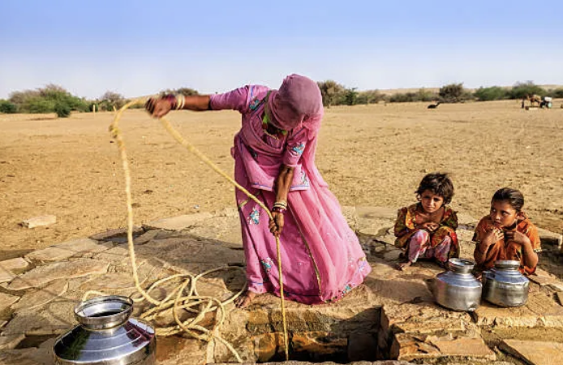


PROBLEM STATEMENT
In rural India, although around 89% of the population had access to an improved water source (within 30 minutes) by 2020, only about 50% of rural households had a tap connection in their home or premises as of May 2022.
Contaminated water leads to diseases such as cholera, typhoid, E. coli-induced diarrhea, and hepatitis.
In rural India, issues persist not just with access, but with the quality, reliability and safety of water services (for example chemical contamination such as fluoride/arsenic) despite infrastructure expansion.
Traditional purification systems are often inaccessible, expensive, or impractical for portable use, creating an urgent need for affordable, sustainable, and on-the-go water purification solutions.
@Electroblitz Club-Department of Electronics and Communication- Dayananda Sagar University
TechnoCognition'25

Slide 3
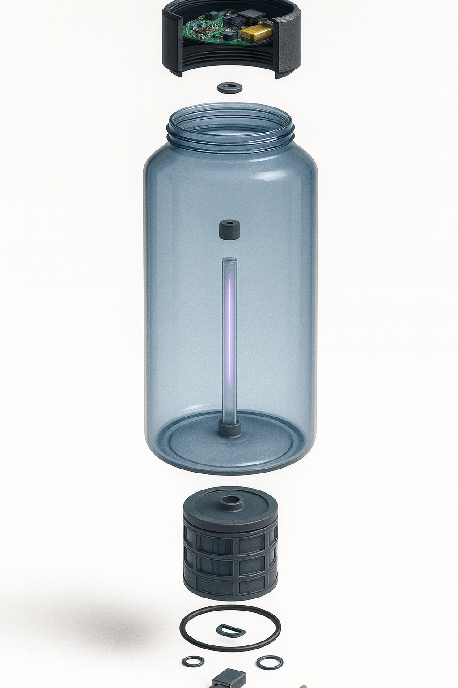
SOLUTION OVERVIEW
Summary :
This study presents a portable 1L water purification system capable of delivering 750 ml of potable water through a three-stage purification process, specifically engineered for deployment in rural and disaster-stricken environments lacking access to conventional water treatment infrastructure.
1. Sediment and Activated Charcoal Filtration
2. UVC LED Disinfection (265–275 nm)
3. Embedded Smart Control System
The device enables water purification within 3–5 minutes, with no dependence on boiling, chemical treatment, or large-scale purification setups. It offers off-grid operability, providing a rapid, and sustainable alternative to bottled water and traditional purification systems—addressing both emergency and long-term potable water needs.
TechnoCognition'25

Slide 4
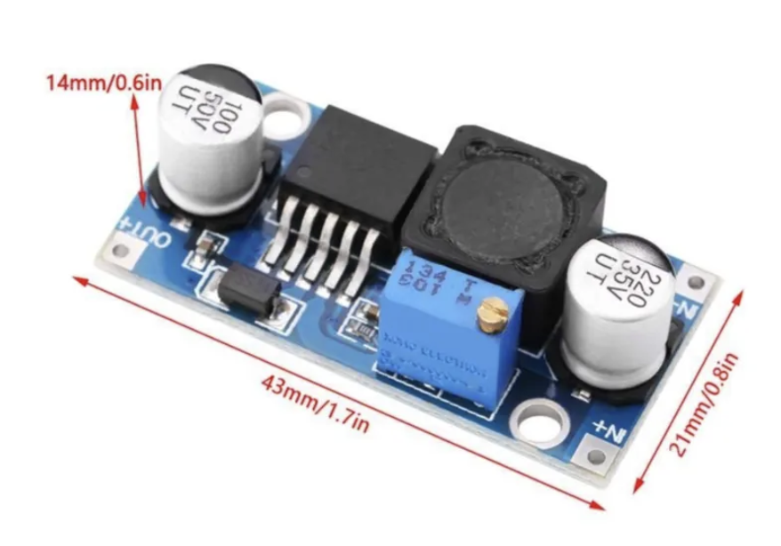
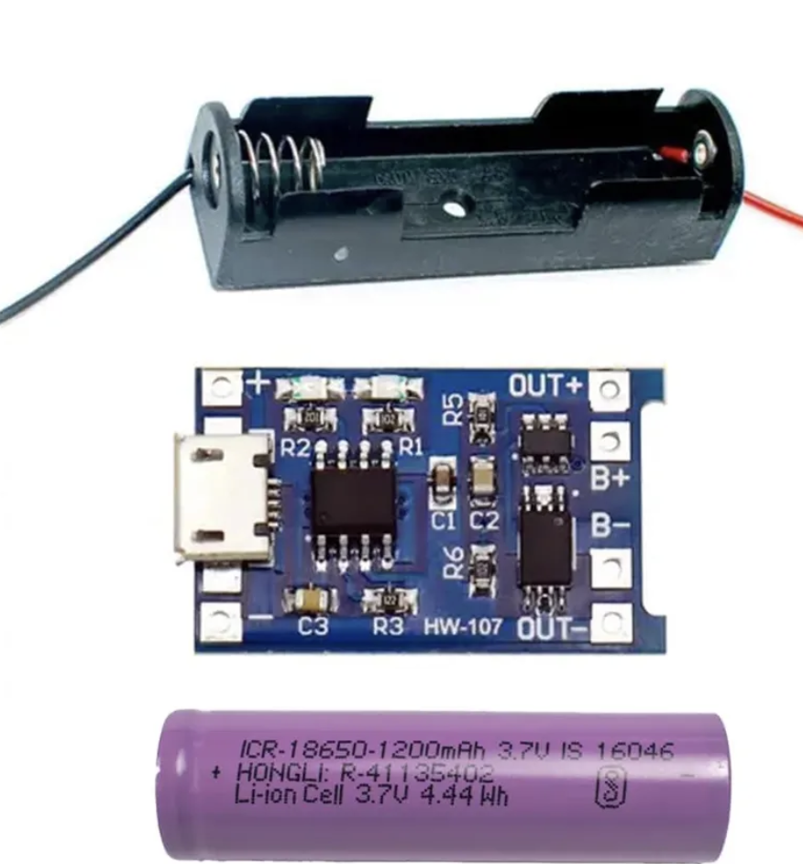
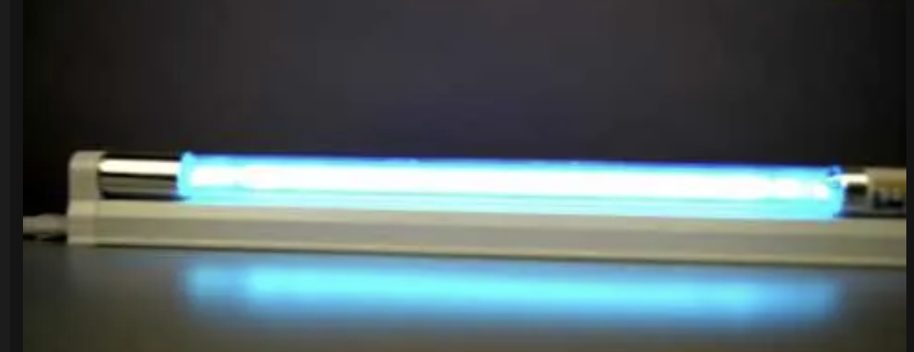
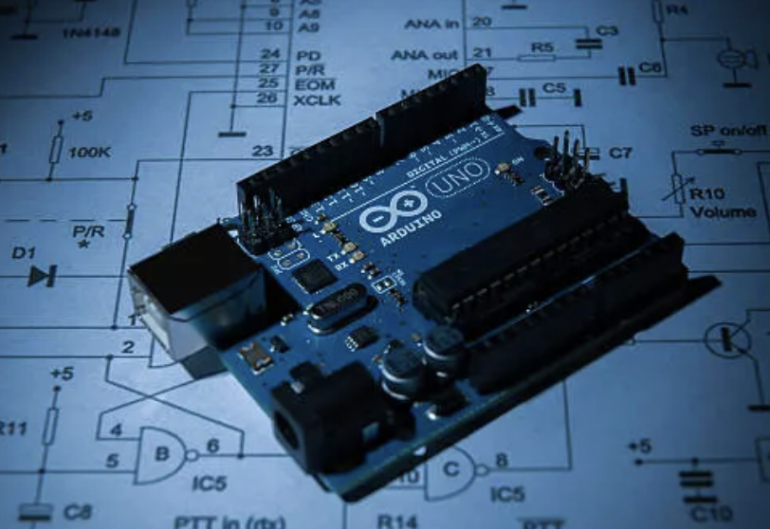
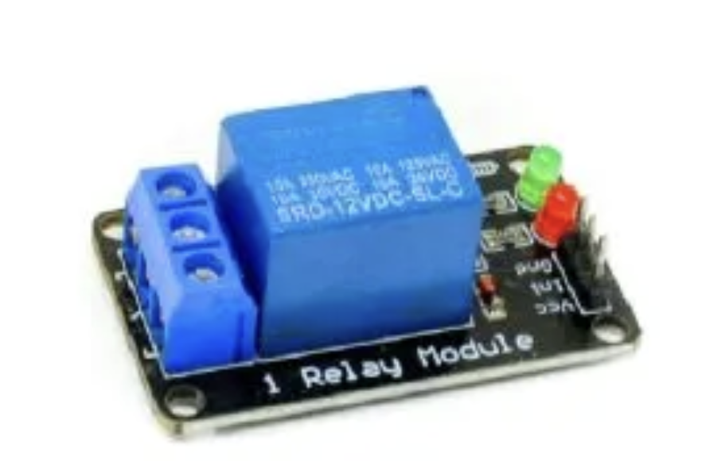
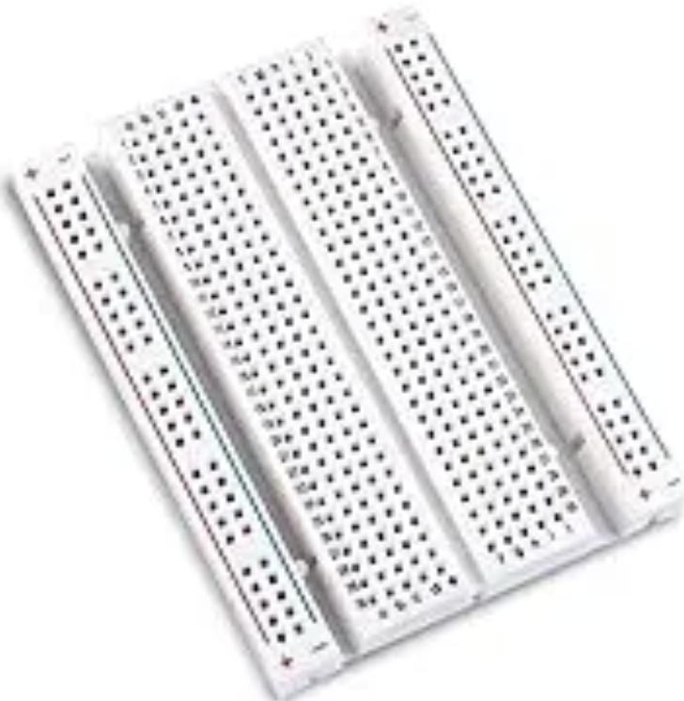
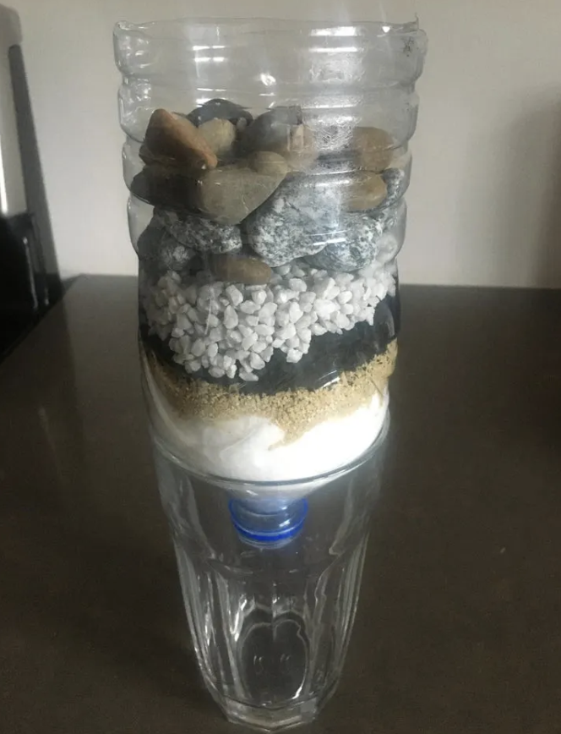

COMPONENTS USED
ARDUINO UNO CHARGING MODULE
UVC-LED ROD
BOOST CONVERTOR
RELAY MODULE
BREADBOARD
WIRES AS PER REQUIREMENT
SEDIMENT FILTRATION
TechnoCognition'25

Slide 5
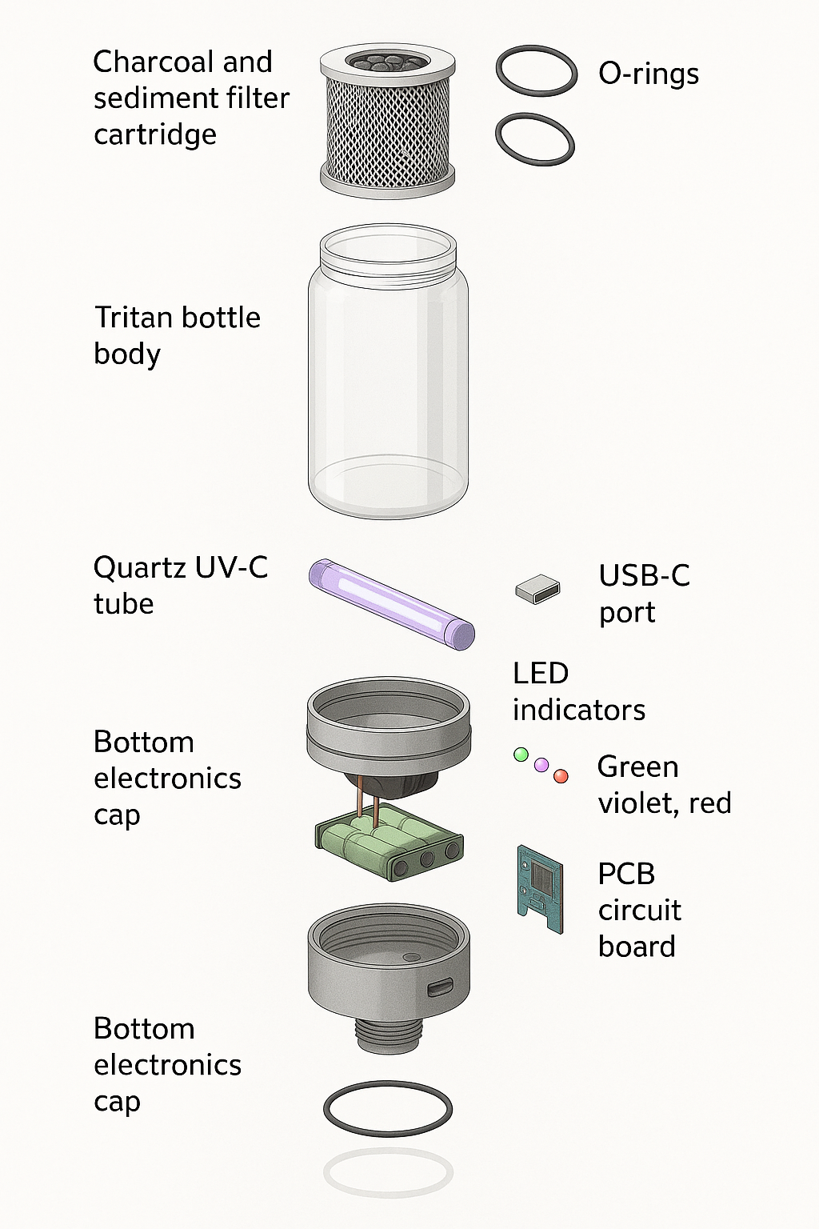
IMPLEMENTATION/PROTOTYPE
Technical Demonstration Overview:
1. 3-Stage Purification in Action:
Shows visible filtration of dirty water → clear water using sediment + charcoal filter.
UVC LED (265–275 nm) activated to kill microbes with ≥40 mJ/cm² dose.
Smart circuit auto-shuts off after safe purification based on turbidity sensor.
2. Fast Purification Cycle:
Converts contaminated water to drinkable water in 3–5 minutes, validated through basic water safety tests.
3. Off-Grid Operation:
Demonstrates power via USB-C/solar panel confirming usability in remote/disaster settings.
4. Field Usability:
Portable design shown filtering real contaminated water during field test simulation.
TechnoCognition'25

Slide 6
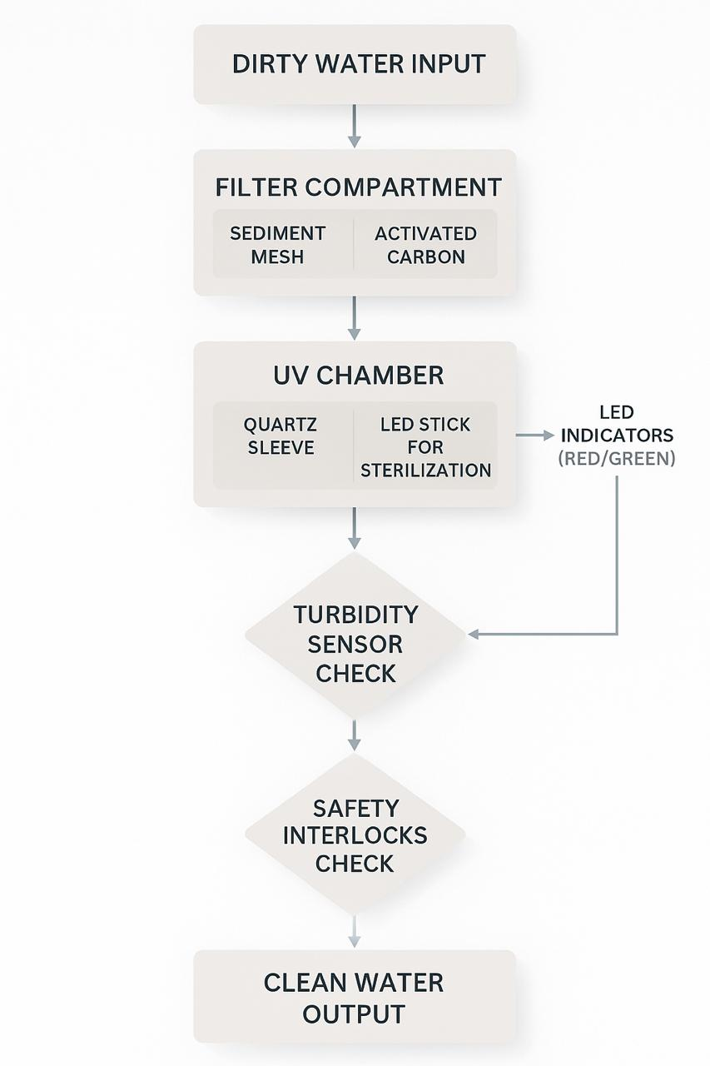
TECHNOLOGY STACK
System Overview
A modular 3-stage portable water purification system integrating:
1. Filtration
2. UVC LED Disinfection
3. Smart Monitoring and Control
Hardware Components
Sediment + Activated Charcoal Filter ,UVC LED Stick (265–275 nm, ≥40 mJ/cm² dose)
Turbidity Sensor (water quality check),UV Intensity Sensor (monitors disinfection dose)
Power System: Rechargeable Li-ion battery (USB-C) + Solar charging option
Software Components
Embedded Firmware (C/C++, Arduino/ESP-IDF)
UV timing and control,Auto shut-off safety logic
Data Flow
1. Contaminated water added to bottle
2. Stage 1: Filtration removes sediment → turbidity measured
3. Stage 2: UVC LED activated → MCU controls UV exposure
4. MCU validates purification → auto shut-off enabled
5. ~750 ml of purified water ready for drinking
TechnoCognition'25

Slide 7
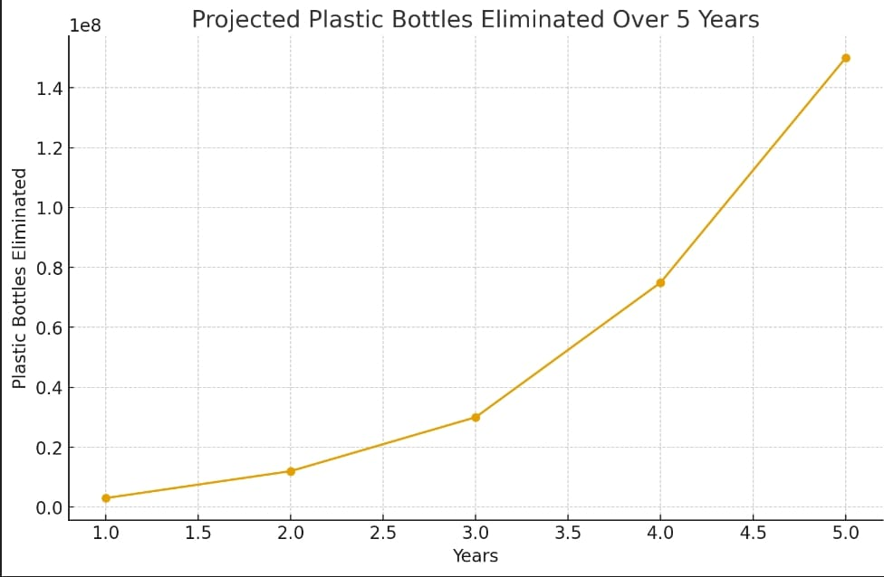
IMPACT & SCALABILITY
Impact, Measurable Outcomes & Global Scalability Strategy
1. Key Value Proposition
99.99% pathogen-free drinking water through multi-stage purification
Ultra-low cost per liter (< ₹0.20), enabling affordability in underserved regions
Eliminates 300+ plastic bottles per user annually and no chemicals
2. 12-Month Measurable Impact Targets
50,000+ people provided access to safe drinking water
≥ 40% reduction in waterborne disease cases in deployment zones
₹10+ crore cumulative savings in bottled water and medical expenses
80% user retention rate after 6 months of adoption
3. Global Scalability Advantages
Modular, low-cost, locally manufacturable design
WHO-compliant water quality and aligned with UN SDG 6
Adaptable to diverse geographies, contaminants, and cultural usage patterns
TechnoCognition'25

Slide 8
RESULTS/FUTURE SCOPE
Key Findings
Field trials confirm effective microbial removal and user acceptability.
Achieved cost-effective purification suitable for low-resource settings.
Preliminary data indicates a decline in self-reported waterborne symptoms.
Resource Requirements
Funding for large-scale trials and sensor integration.
Partnerships for rural distribution, water testing, and compliance.
Future Scope
Advanced Filtration Modules:Develop interchangeable cartridges targeting region-specific contaminants.
Smart Monitoring Integration:IoT-based sensors for real-time water quality tracking, usage analytics, and predictive maintenance.
Sustainable Manufacturing Model: Establish decentralized micro-manufacturing units for local production and maintenance.
Impact Assessment Studies: Conduct longitudinal health impact and cost-benefit analyses in collaboration with public health researchers.
Global Humanitarian Partnerships: Align with NGOs, disaster relief agencies, and CSR initiatives for rapid adoption in vulnerable regions.
TechnoCognition'25

